Slide 1
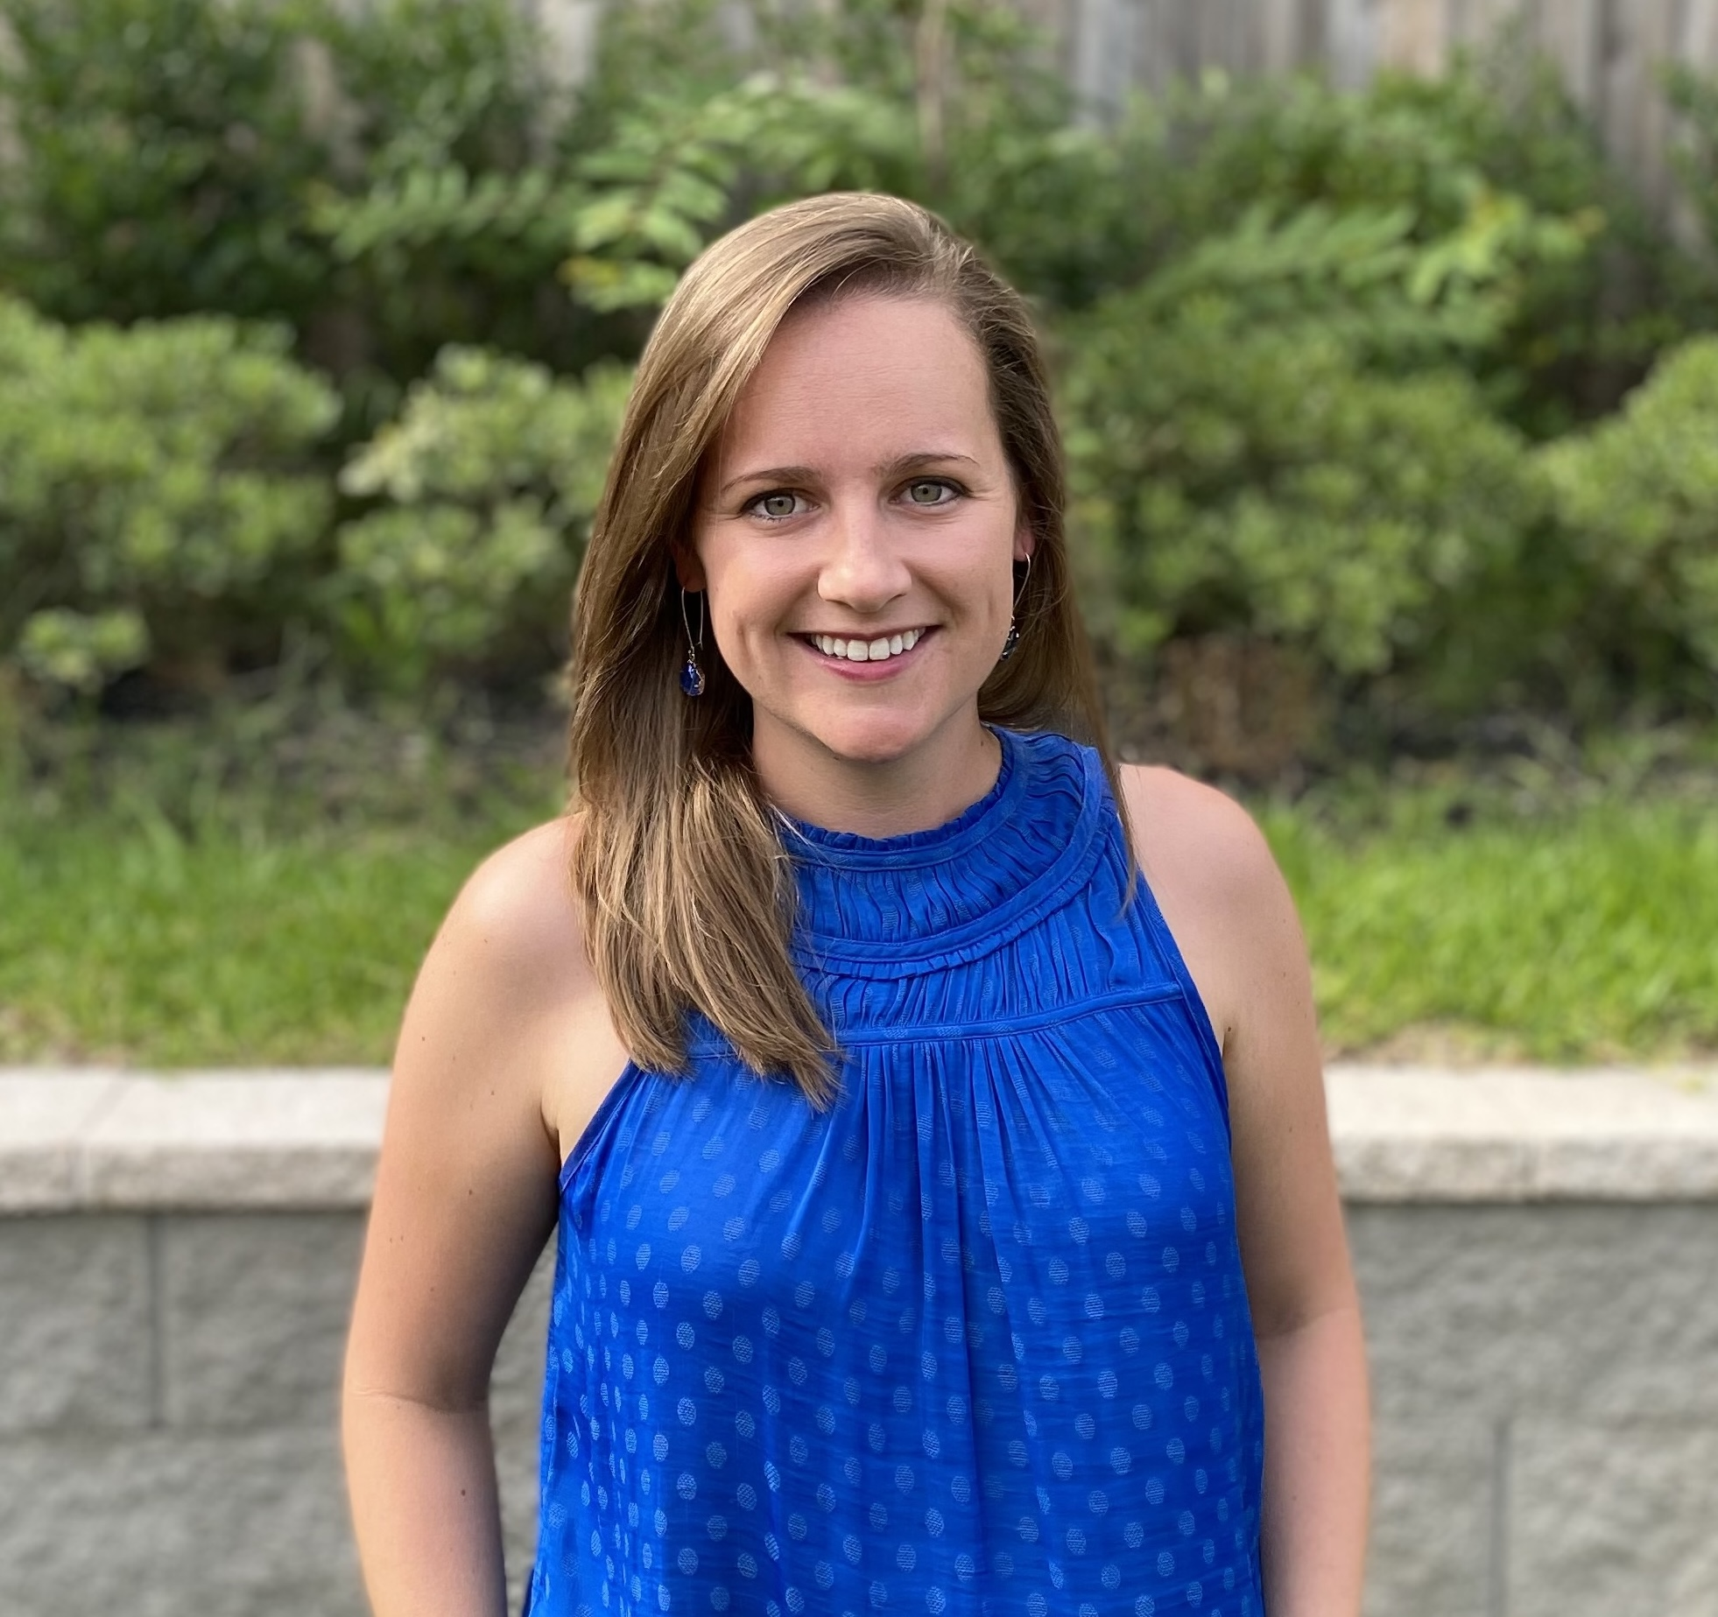
Brittany Wadsworth Director — Cloud & Product
Email
brittany.wadsworth@thebridge.com
Location
Houston, Texas
Mobile
(713) 834-7501
Brittany joined The Bridge in July 2024. She has experience working with organizations both large and small. Her passion is bringing together people, processes, and technology thus providing results that are secure, adaptable, and compliant.
EXPERIENCE
Industry Experience
Financial Services | Technology | Energy | Healthcare | Legal | Real Estate
Enterprise Security Strategy & Execution | Financial Services
Established and directed an Information Security Program in line with SOC 2 Type II and ISO 27001 standards
Partnered with Legal, People, and Technology teams to align policy, processes, and systems for security and compliance
Collaborated directly with development team to ensure secure cloud workloads, integration with SaaS services, and core identity and access management
Maintained the full suite of Security Tools including Automated Compliance Platform, Identity Provider, SIEM/SOAR, Data Loss Prevention, CASB, AV/Anti-Malware, and Device Management platforms
Cloud Security Architect | Healthcare
Security Architect directly responsible for designing a HIPAA compliant cloud application
Defined and documented the overall architecture / direction of infrastructure and network resources
Worked directly with developers to ensure compliance across all portions of our DevOps pipelines and SDLC processes
Designed, deployed, and documented logging and monitoring strategy across all parts of the application
BACKGROUND
Functional Skills
Security Strategy, Security Program Management, Cloud Architecture, Cloud Security, Compliance Management, Identity & Access Management, Data Loss Prevention
Qualifications
Technology leader focused on Cloud & Security. Brittany has served as lead architect on numerous cloud, security, and governance projects, including an Enterprise Security Strategy and Cloud Security project

Slide 2

Email
brittany.wadsworth@thebridge.com
Location
Houston, Texas
Mobile
(713) 834-7501
Brittany joined The Bridge in July 2024. She has experience working with organizations both large and small. Her passion is bringing together people, processes, and technology thus providing results that are secure, adaptable, and compliant.
Brittany Wadsworth Director
Cloud & Product

Slide 3
Brittany Wadsworth Director — Cloud & Product
Email
brittany.wadsworth@thebridge.com
Mobile
(713) 834-7501
Location
Houston, Texas
BACKGROUND
EXPERIENCE
Functional Skills
Security Strategy, Security Program Management, Cloud Architecture, Cloud Security, Compliance Management, Identity & Access Management, Data Loss Prevention
Qualifications
Technology leader focused on Cloud & Security. Brittany has served as lead architect on numerous cloud, security, and governance projects, including an Enterprise Security Strategy and Cloud Security project
Industry Experience
Financial Services | Technology | Energy | Healthcare | Legal | Real Estate
Enterprise Security Strategy & Execution | Financial Services
Established and directed an Information Security Program in line with SOC 2 Type II and ISO 27001 standards
Partnered with Legal, People, and Technology teams to align policy, processes, and systems for security and compliance
Collaborated directly with development team to ensure secure cloud workloads, integration with SaaS services, and core identity and access management
Maintained the full suite of Security Tools including Automated Compliance Platform, Identity Provider, SIEM/SOAR, Data Loss Prevention, CASB, AV/Anti-Malware, and Device Management platforms
Cloud Security Architect | Healthcare
Security Architect directly responsible for designing a HIPAA compliant cloud application
Defined and documented the overall architecture / direction of infrastructure and network resources
Worked directly with developers to ensure compliance across all portions of our DevOps pipelines and SDLC processes
Designed, deployed, and documented logging and monitoring strategy across all parts of the application

Slide 4










 | USE OVER DARK BACKGROUND | USE OVER LIGHT BACKGROUND
STRATEGY & ADVISORY
DATA & AI
EXPERIENCES
CLOUD & PRODUCT
ACCELERATION

